Slide 1


MC Simulations with non-constant Parameters
Sebastian Caceres
Pablo Gomez

Slide 2
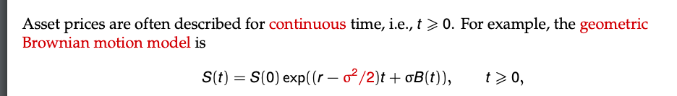
Introduction
In class, we have used Montecarlo simulations to price different options.
For European options, we used Geometric Brownian Motion to simulate paths for the stock price.

Slide 3

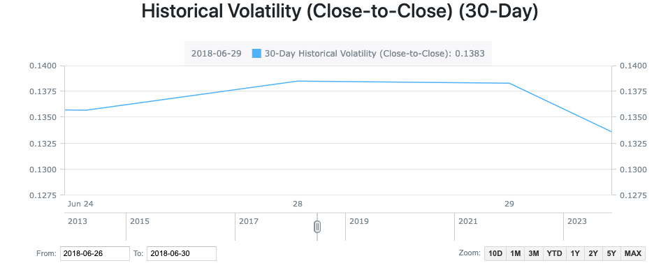
Model Limitations
The model assumes constant risk-free rate and volatility of the stock price.
In the real world, these parameters are not usually constant.

Slide 4
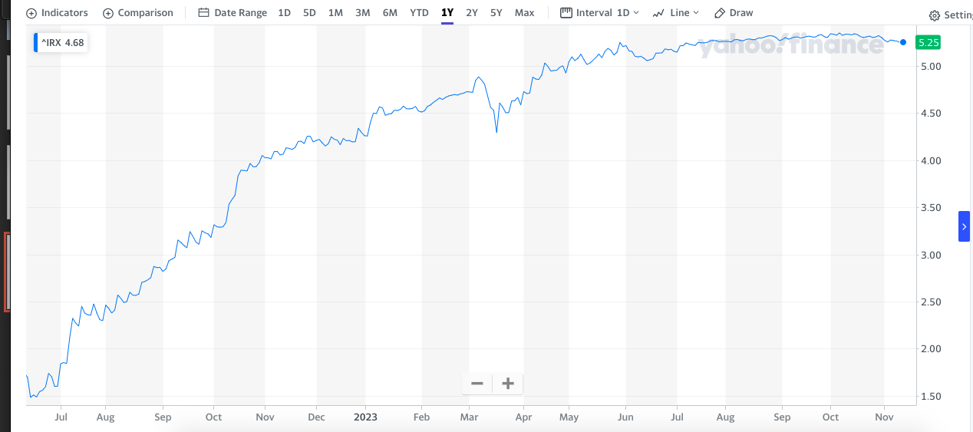
US 13-week Treasury Bill Rate

Slide 5
Two different models
Variable interest rate
Vasicek Model
Variable volatility
Heston Model

Slide 6

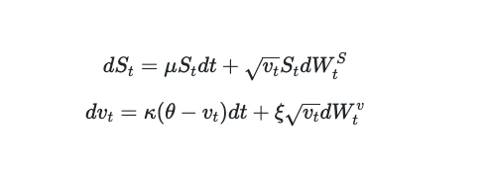
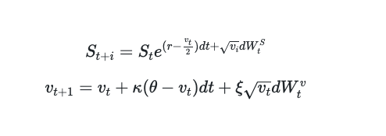
Heston Model
Stochastic Volatility
Heston Model

Slide 7
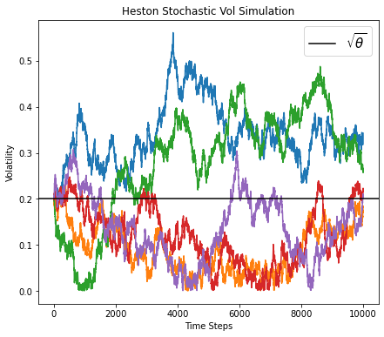
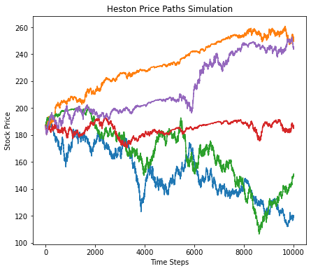
Graphs for the Heston Model
Heston Model

Slide 8
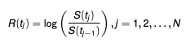
Parameter Calculation
For the model, we need to estimate 4 parameters.
We used the method of moments to estimate the 4 parameters using market data.
We retrieved the closing price for Apple stock for the past ten years.
We calculated the returns using the following formula
Heston Model

Slide 9
Method of Moments
For the method of moments, we calculate the parameters by matching the sample moments with the theorical moments from the distribution.
We calculated the first 4 moments for the Apple stock return data and matched them to the theorical moments, since we need to estimate four parameters.
Heston Model

Slide 10
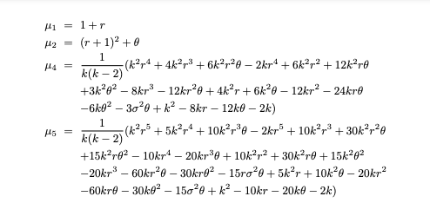
We got r = 0.005, Kappa= 0.8310, theta = 0.07 sigma = 0.001

Slide 11
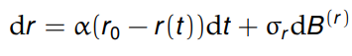
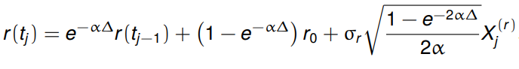
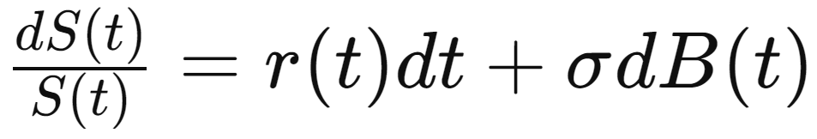
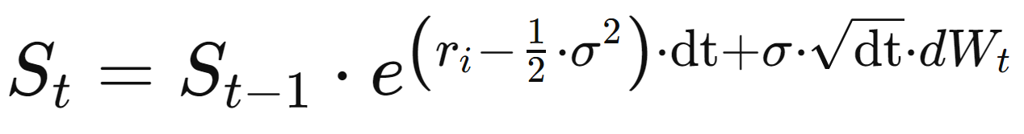
Vasicek Model
Vasicek Model

Slide 12
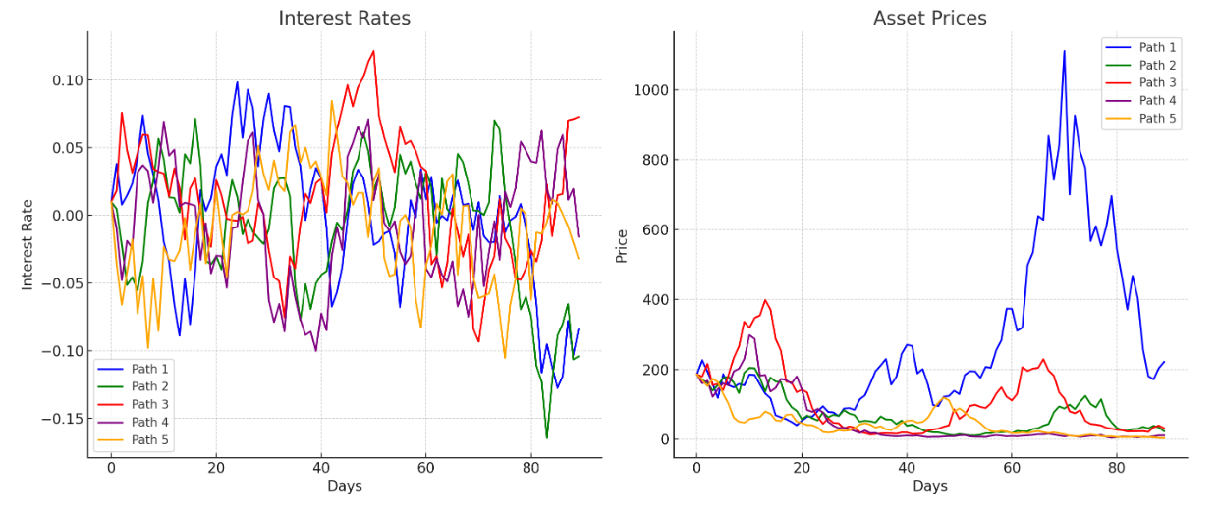
Graphs for the Vasicek Model
Vasicek Model

Slide 13

Implied Volatility
Implied volatility is a measure of the market’s projection for future volatility.
It is a function of supply and demand plus the time to expiration of the options that are used to calculate it.
We calculated implied volatility by using data for Apple options prices.
The model we used was the Black Scholes equation. Instead of solving for the price of the option, we solved for volatility.

Slide 14
Implied Volatility Calculation
We found the price for a call option for Apple with the following parameters:
- Strike price: $185
- Expiration date: November 24th
- Current stock price: $187.44
- Risk free rate: 5.22%
We used the MATLAB function blsimpv to calculate the implied volatility using the Black Scholes model.
We calculated an implied volatility of 16%.
We included this implied volatility in the Vasicek Model.

Slide 15
Montecarlo Simulation
We used the Heston model to simulate multiple paths for Apple’s stock price with varying volatility,
Similarly, we simulated different paths for the stock price using the Vasicek model with varying risk-free rate.
We calculated the payoff for each path and computed the average payoff. The average payoff is the fair option price.

Slide 16
Code
We tried to code the simulations in Python/MATLAB but the run time was very long.
As we discussed earlier in the semester, one of the problems with MATLAB is that the code runs slower than other programming languages .
To solve this problem, we coded our simulations in C++, which significantly decreased the time it took to run the simulations.
Prices for the call option:
- Heston Model = $23.55
- Vasicek = $21.80

Slide 17

Future Works
Our models consider stochastic risk-free rate or volatility, but we don’t consider both parameters varying at the same time.
We only calculated the fair price for European options. In the future, we could expand our project to price American, Asian and exotic options.
We could try a different method to estimate model parameters, such as Maximum Likelihood Estimation .

Slide 18
References
1. https://www.valpo.edu/mathematics-statistics/files/2015/07/Estimating-Option-Prices-with-Heston
2. https://www.codearmo.com/python-tutorial/heston-model-simulation-python
3. https://www.investopedia.com/terms/i/iv.asp#:~:text=What%20Is%20Implied%20Volatility

Slide 19
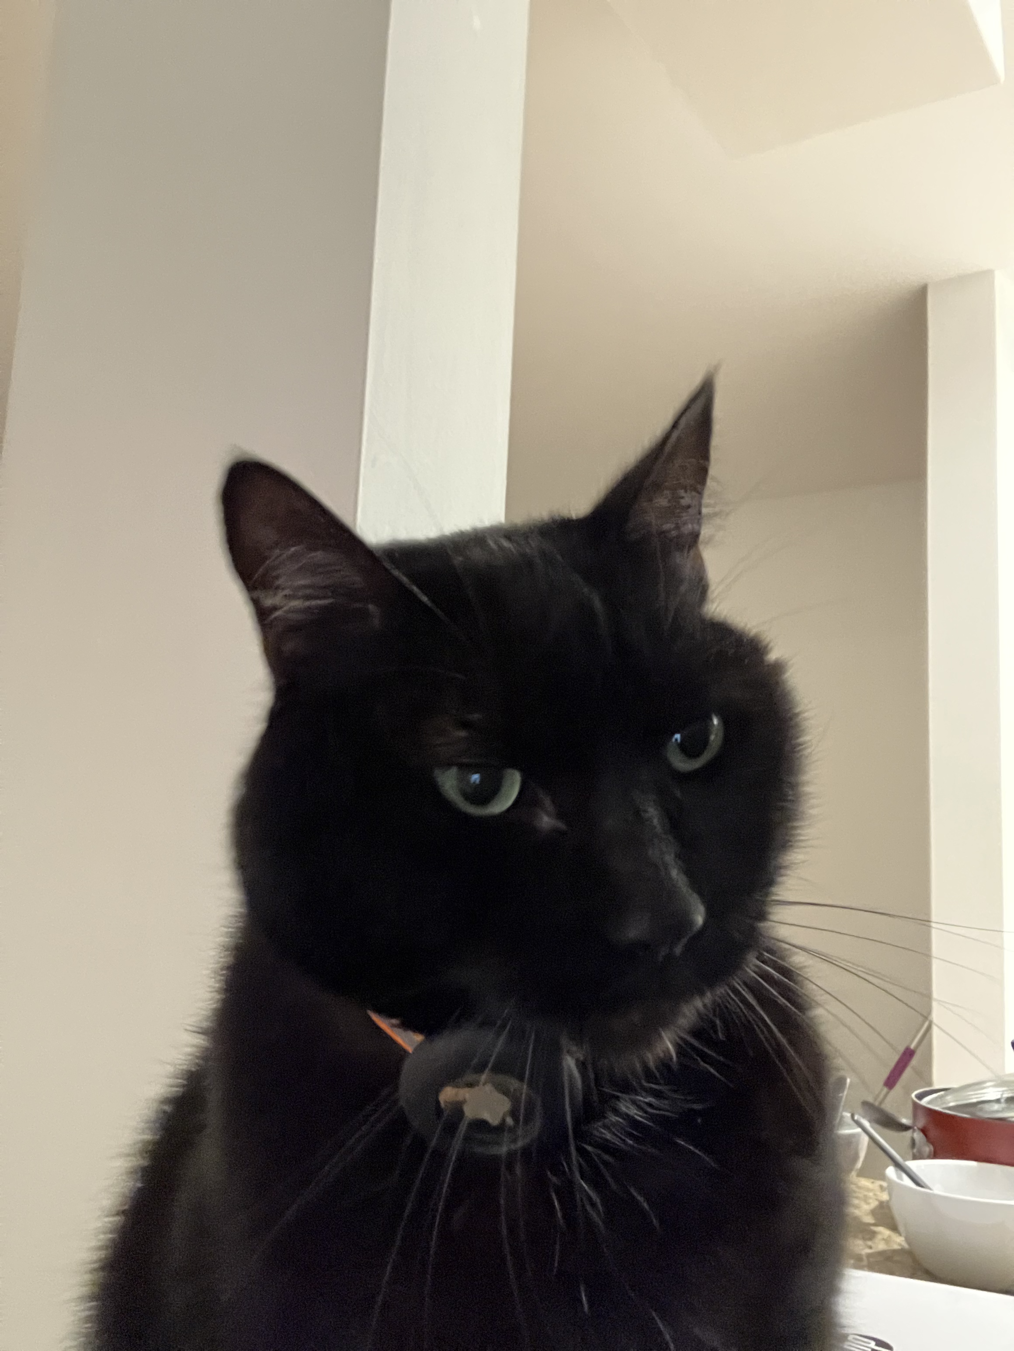
Thank you for Listening!

